Slide 1
CS2164 Lesson 8 Feb 22, 2016
Intro to programming using C
Instructor: Gustavo Sandoval
gustavo.sandoval@nyu.edu

Slide 2
From last class

Slide 3
Fibonacci numbers
F0 = 1,
F1 = 1,
In general
F (i + 1) = F(i) + F(i – 1) for I = 1, 2…
One property is that the Fibonnaci quotients defined by:
Q(i) = {F (i) / F(i – 1)} for i = 1, 2, 3
Converges to the golden mean, which is (1 + sqrt(5))/2
Up to N = 46
Fibonacci.c

Slide 4
True and False in C
Remember we talked about the (unary) negation operator !
Most experienced programmers would wince at the expression:
if (a != 0)
….
Since C doesn’t have a boolean type. Then integer acts as such
People write:
if (a)
Because if a isn’t zero it acts as true;
Example:
done = 1;
if (done)
…

Slide 5
New stuff

Slide 6
Break Statement
Remember loops ? For, while and do/while ?
The break statement allows you to exit a loop at any point within it’s body.
The loop is immediately terminated
Program control resumes at the next statement following the loop
It’s better to use for special purposes.
Commonly used with Switch, which we will see later today.

Slide 7
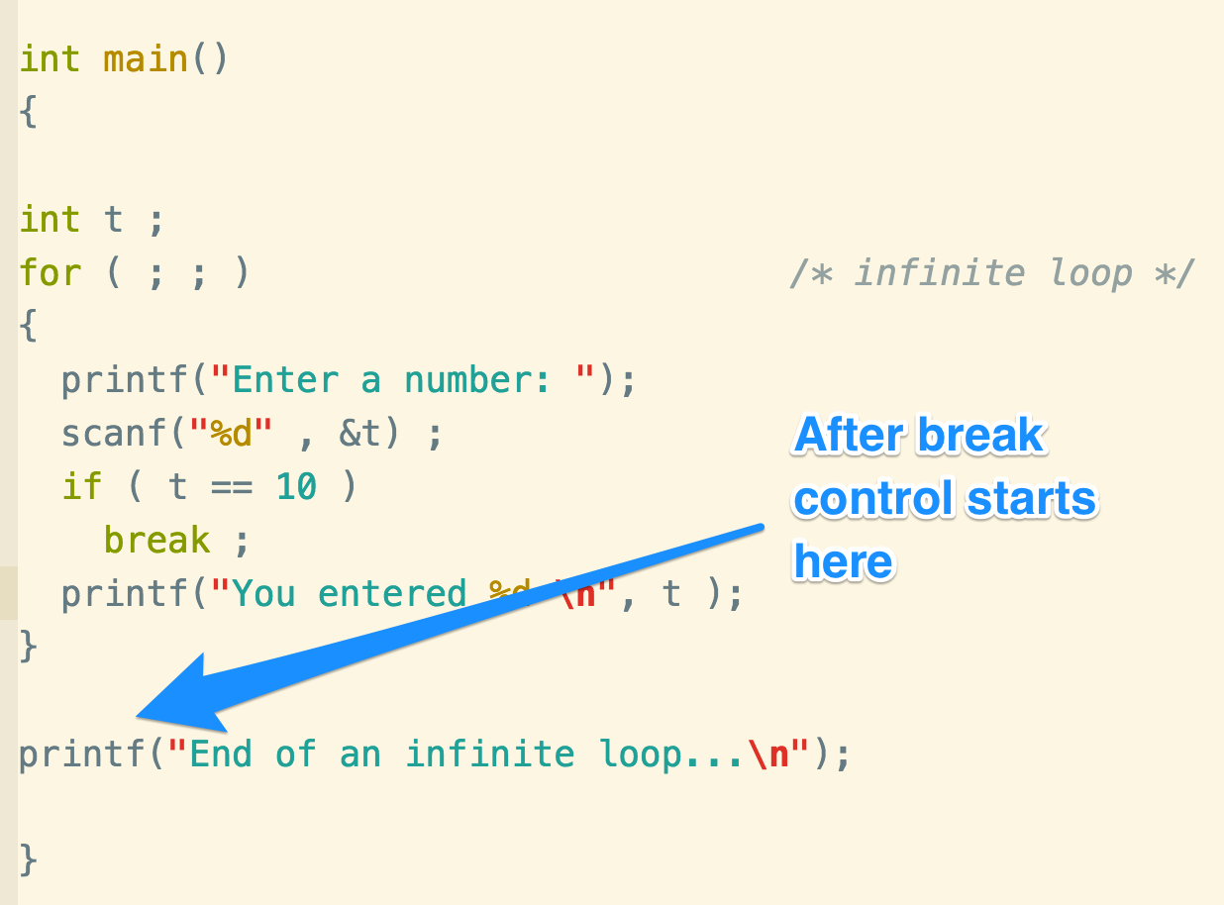
Break continued…

Slide 8
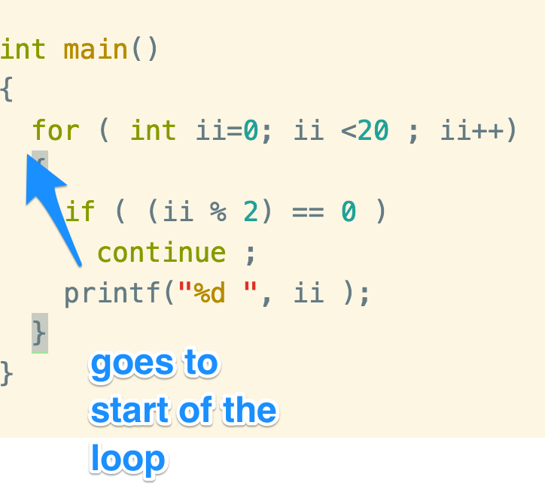
Continue statement
The opposite of break
Forces the next iteration of the loop to happen
Skipping any code in between itself and the test condition of the loop

Slide 9
Return statement
Causes control to be passed back to the calling environment.
If an expression follows the keyword return , then the value of the expression is passed back as well.
Example:
float minimum(float x, float y)
{
if (x < y)
return x;
else
return y;
}

Slide 10
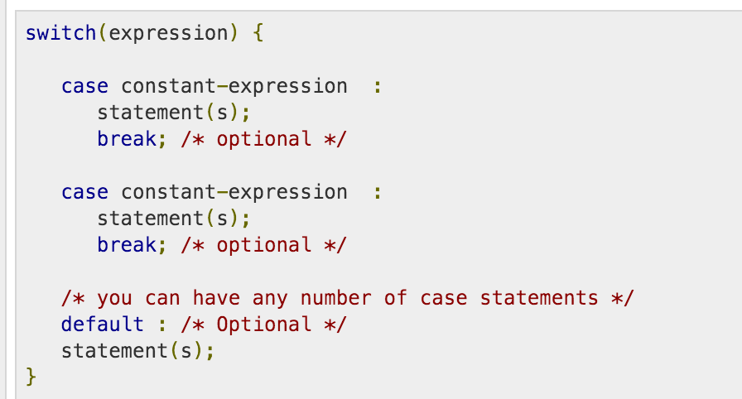
Switch statement
Allows a variable to be tested for equality against a list of values.
Each value is called a case
The variable being checked on for each switch case.
Syntax:

Slide 11
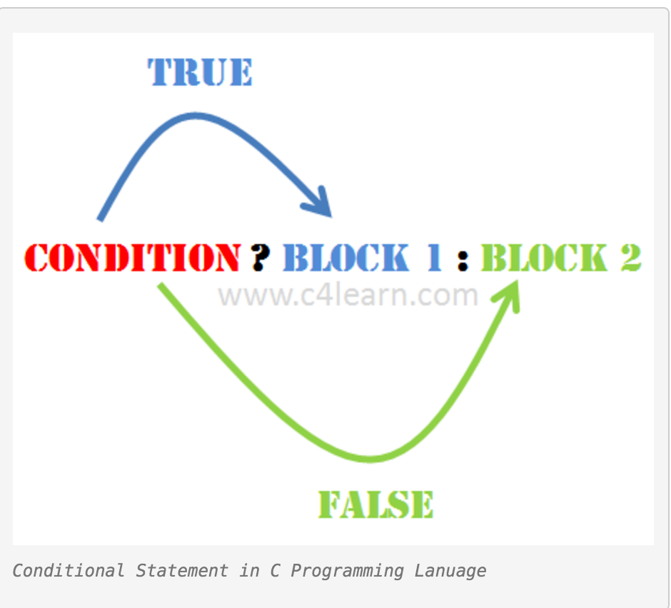
Conditional operator
Also called the ternary operator
Also called the ? : operator
Syntax:
Expression1 ? Expression 2 : expression3
Meaning:
if (condition)
Block1
else
Block2

Slide 12
You can write this:
float min(float x, float y)
{
if (x < y)
return x;
else
return y;
}
Or this
float min(float x, float y)
{
float result;
result = x < y ? x : y ;
return result;
}

Slide 13
Goto statement
WARNING: Try NOT to use it.
It should be used rarely.
The only correct use (in C not C++) is for error handling.
If you are using it for something else you are doing it wrong.

Slide 14
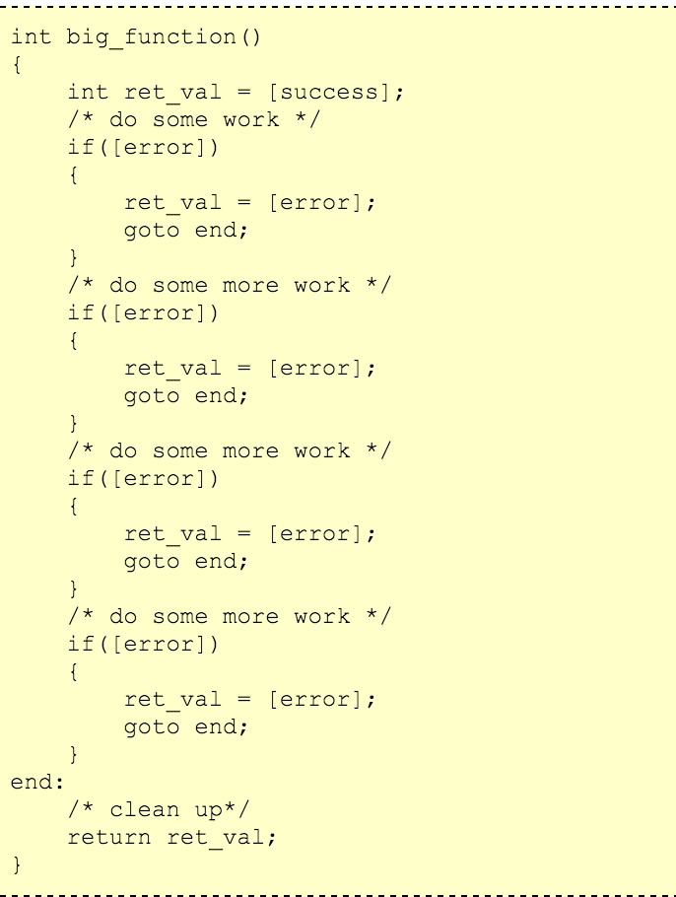
Goto Continued…

Slide 15
SUMMARY OF FLOW OF CONTROL

Slide 16
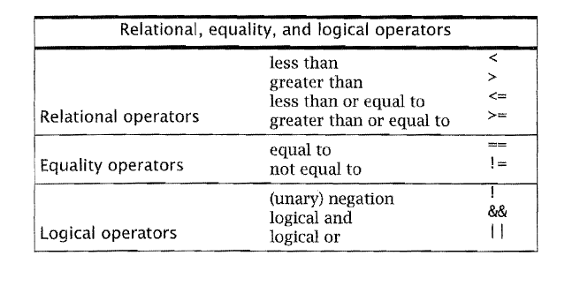
All of these operators have the int value 0 or 1
Their chief us is to test data to affect flow of control

Slide 17
An if statement provides a way of choosing on whether or not to execute a statement.
The while, for and do statements provide for iterative execution.
The body of a do statement executes at least once.
To avoid infinite loops make sure the expression controlling the loop eventually becomes 0.
These four statements cause unconditional flow of control and should be minimized.
goto
break
continue
return

Slide 18
functions

Slide 19
Functions …
Equivalent to what other languages call subroutines or procedures
It’s a chunk of statements grouped together and given a name
You can call it repeatedly by writing the name
For example a greeting function
Example: greeeting.c
Notes:
Have been using them all along already
Main is a function (special one)

Slide 20
Function Design
Useful not only for repeated use of functionality
But also for breaking down a problem.
For example:
Write a program that prints each line of its input that contains a particular string.
Functionally can be decomposed into:
While (MoreLInes()
If LIneContainsPattern()
Print it

Slide 21
Functions and Local Variables
A function is a complete program subunit
You can declare variables within it just like you can on main
The variable *scope* is just within the function
Variables declared inside a function are called Local variables
Local Variables only exist within the scope of a function.
Every time you enter the function the local variable is created and initialized all over again.
Example:
Locals.c

Slide 22
Returning values
So how do we return values ?
One option is returning a value with the return statement
Example:
Return.c
Notes:
A lot of this we have seen

Slide 23
Passing values
Two options:
By Value
By Reference
We have only used by value which doesn’t change the *value*.
By reference we pass the **address** of the variable in memory so that we can change it.
See example:
Passby.c

